Slide 1
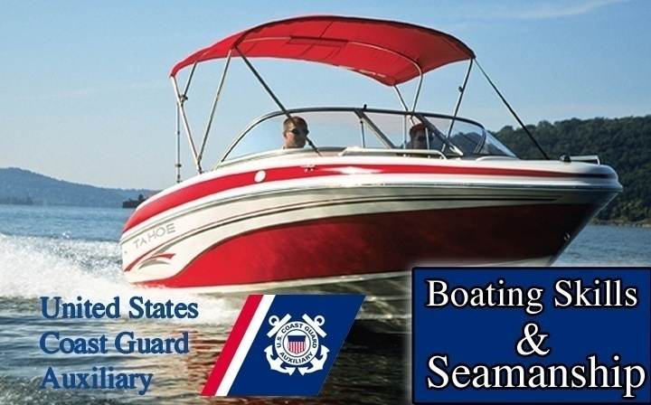
Boating Safety
Chapter
8

Slide 2
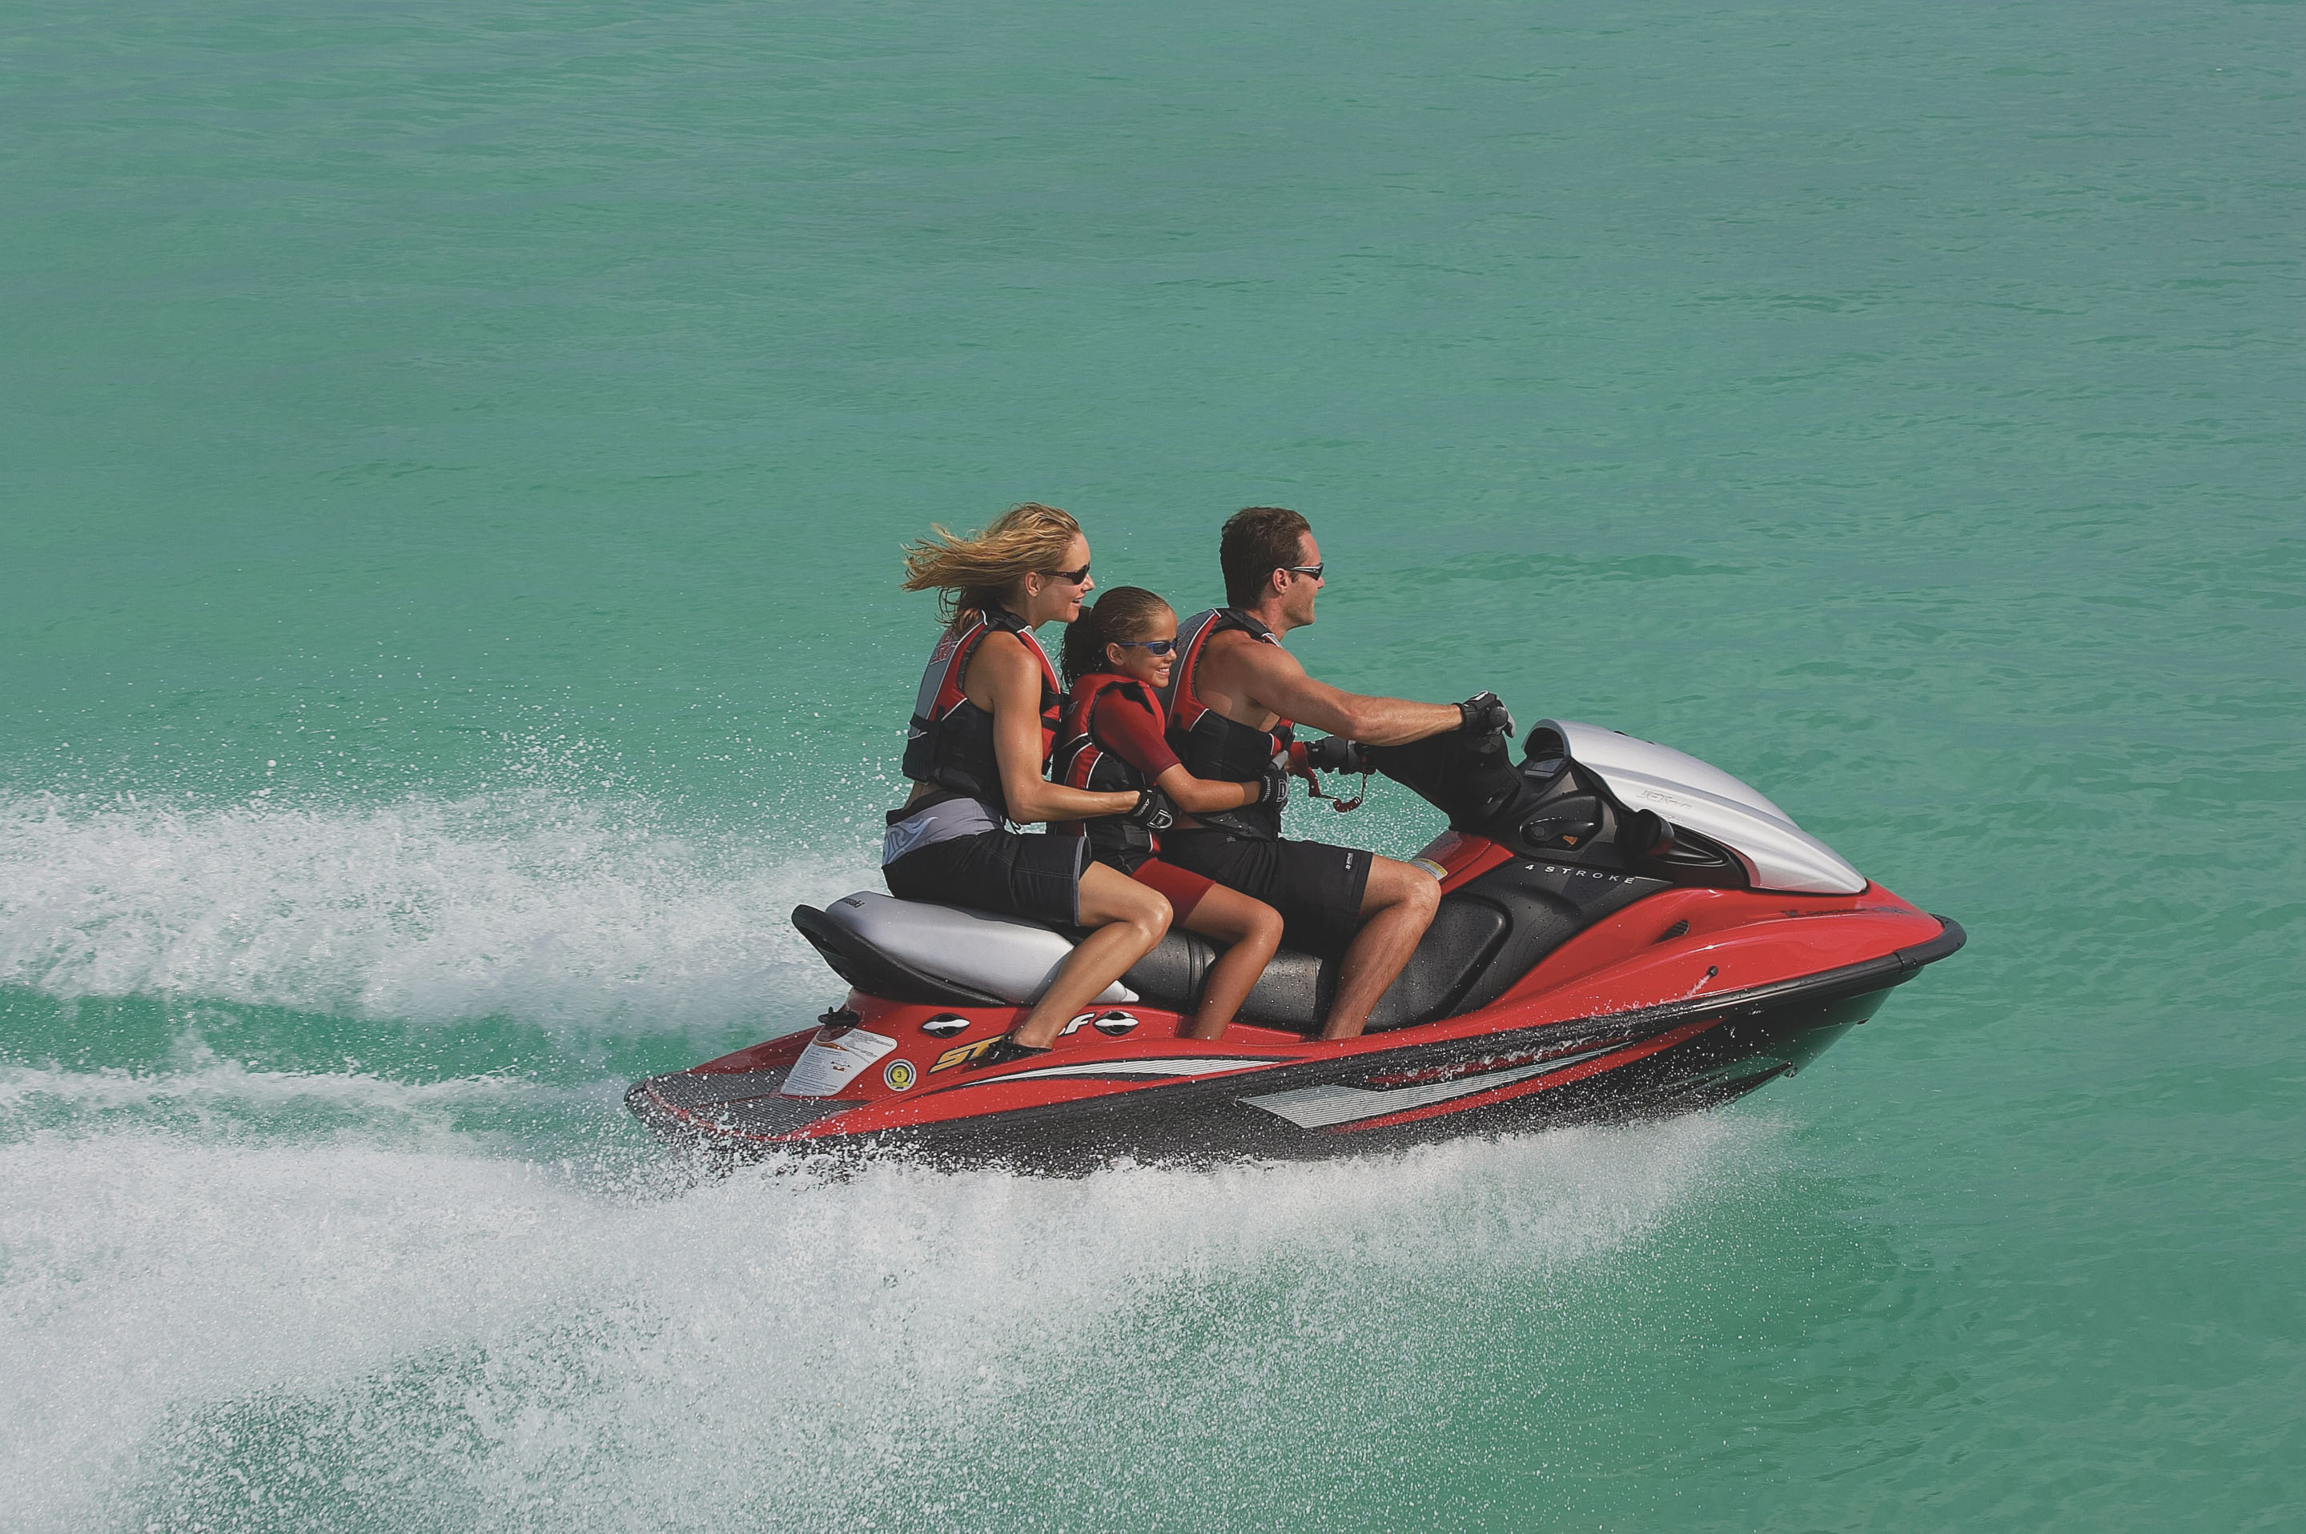
Boating Safety
Chapter
8

Slide 3

Lesson Objectives
Accidents and Prevention
Personal Watercraft Safety
Cold Water Immersion/Hypothermia
Sailboats
Carbon Monoxide
Weather Information Sources and Danger Signs

Slide 4
Small Boat Safety
Passenger briefing
  Locations of Life Jackets
  Fire extinguishers
  First Aid Kit
  Flares
  Operating the Radio
  Using the boat’s toilet
  Handing lines
  Recovering a person who has fallen overboard
  Docking
  Anchoring

Slide 5
Small Boat Safety
Knowing the location of safety items saves time when seconds count
Prepare a plan before its needed
Be able to respond to a situation

Slide 6
Small Boat Safety
Factors in boating fatalities
  Human error is a major factor
  Half occur on lakes and ponds
  More than half occur in boats 12 to 16 feet long
  People often not wearing PFDs
  Use of drugs and alcohol
  Falling overboard and drowning

Slide 7
Small Boat Stability
Avoid swamping a boat in two ways
  Don’t take a small boat out in rough water
  Understand how your boat floats

Slide 8
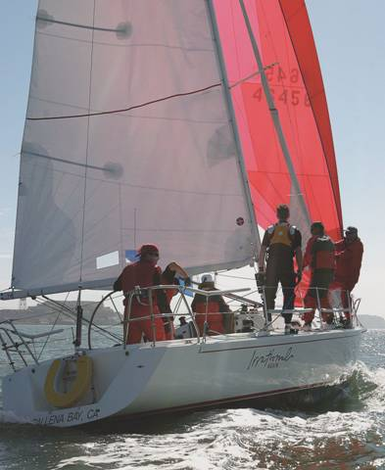
Small Boat Stability
A boat’s ability to resist capsizing depends on its
  Hull shape
  Amount of buoyancy
  Center of Gravity
  Center of Buoyancy

Slide 9
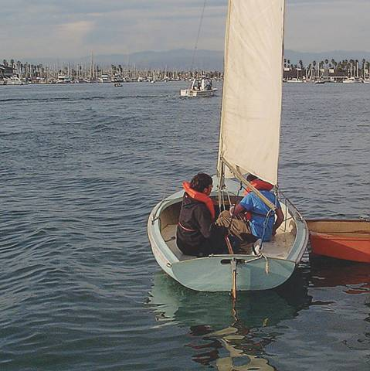
Small Boat Stability
Overloading is a key factor
  Changes the center of gravity
  Lowers boat’s freeboard

Slide 10
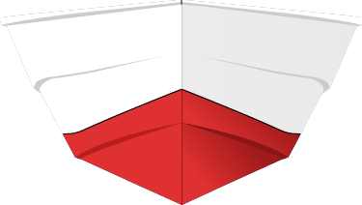
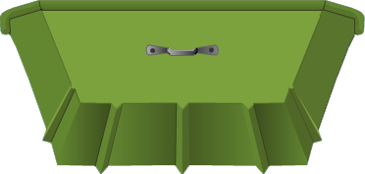
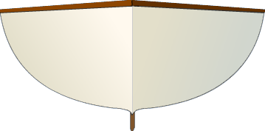

Small Boat Stability
vee bottom
flat bottom
round bottom
multi-hull

Slide 11
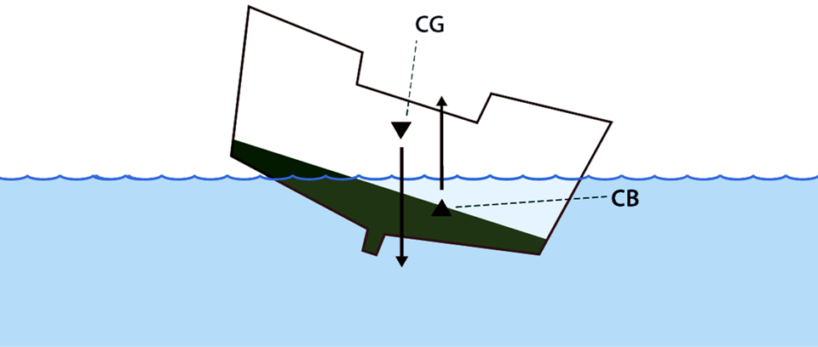
Small Boat Stability
In waves the center of gravity and the center of buoyancy shift from over the keel

Slide 12
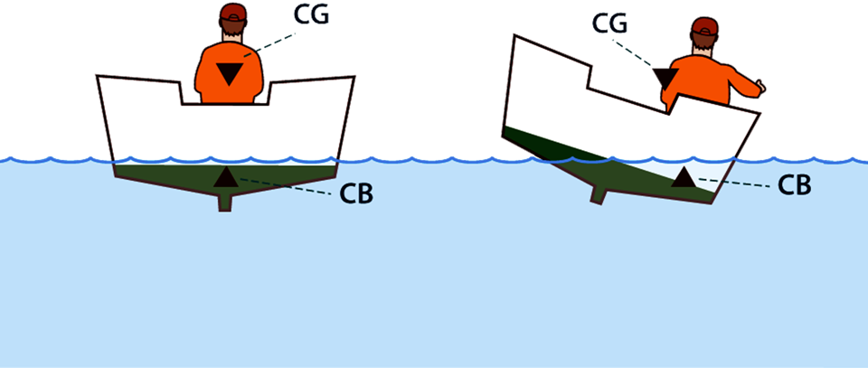
Small Boat Stability
At rest in equilibrium
Weight shifted
Boat is stable
Center of Mass
Boat is unstable
Swamps or Capsizes

Slide 13
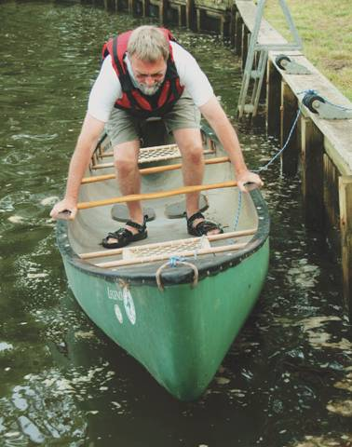
Small Boat Stability
Load boat carefully keeping it level
Don’t stand up
Secure cargo
Maintain three point contact
Hold both sides and at least one foot on the deck

Slide 14
Small Boat Stability
If your boat capsizes
  Stay with your boat!
  Climb on it if possible
  The colder the water the more urgent it is to get out of it
  It is easier for rescuers to see you on the boat

Slide 15
Student Activity
The three factors leading to capsizing
Overloading
Shifting of CG
Shifting of CB
1
2
3

Slide 16
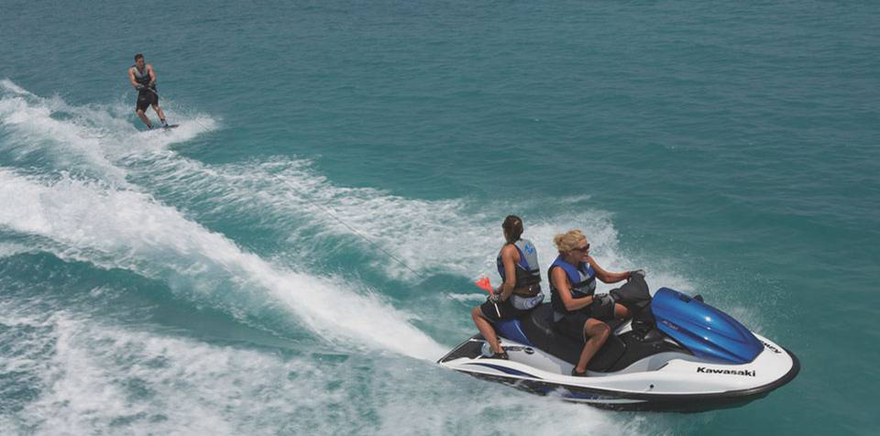
Personal Watercraft
Are Class A motorboats
Subject to Navigation Rules
Equipment – federal, state local
Highly unstable

Slide 17
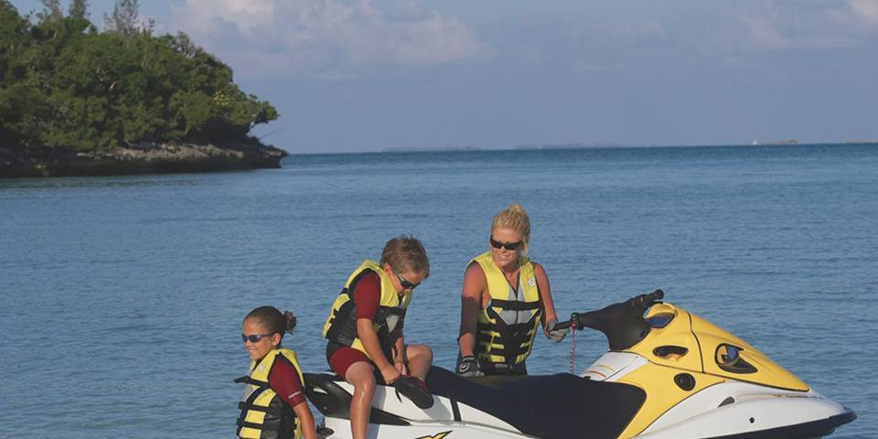
Personal Watercraft
Understand operator responsibility
Have respect for others
Know safety equipment
Safety considerations
Note: PFDs

Slide 18
Personal Watercraft
A PWC moving at high speed may not be able to see an object in the water
Dangerous loss of steering ability may occur with rapid throttle release

Slide 19

Personal Watercraft
Safety considerations
  Visibility
  Man overboard
  Cutoff switch with safety lanyard
  Avoid deep water until competent
  Hypothermia

Slide 20
Swimming Near Boats
Faulty electrical grounding may result in electrocution
  Risk greatest in fresh water
  Faulty shore power or boat power
  Only 6 mA can cause death
Equipment Leakage Circuit Interrupter (ECLI) – boat: cuts power if problem
Ground Fault Circuit Interrupter (GFCI) – shore: cuts power if problem

Slide 21
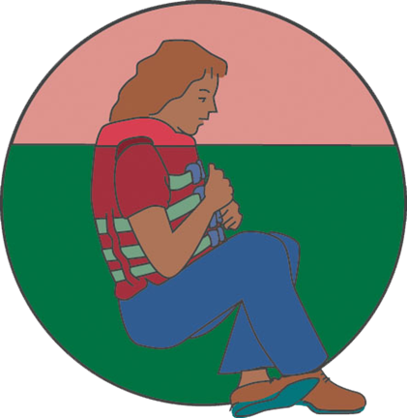
Cold Water
Falling into cold water may cause:
  Cold shock
  Hypothermia
  Drowning
But:
  Warm clothing helps
  Crouched position
  Seek medical help

Slide 22
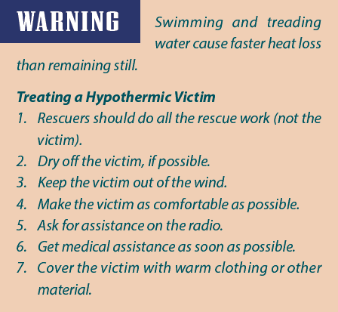
Cold Water - Hypothermia
Lowering of body temperature
Biological functions stop Rapid heat may occur with swimming
Can occur in warm waters
First sign is goose flesh Can occur in a strong wind when dry
TABLE 8-1
Approximate Median Lethal Exposure Times
Times (hours)
Water temperature (°F)
35
45
55
65
70
Floating
with PFD
1.75
2.50
3.50
7.75
18.00
Treading
Water
1.25
1.75
3.00
5.75
13.00
Swimming
0.75
1.00
2.00
4.50
10.00

Slide 23
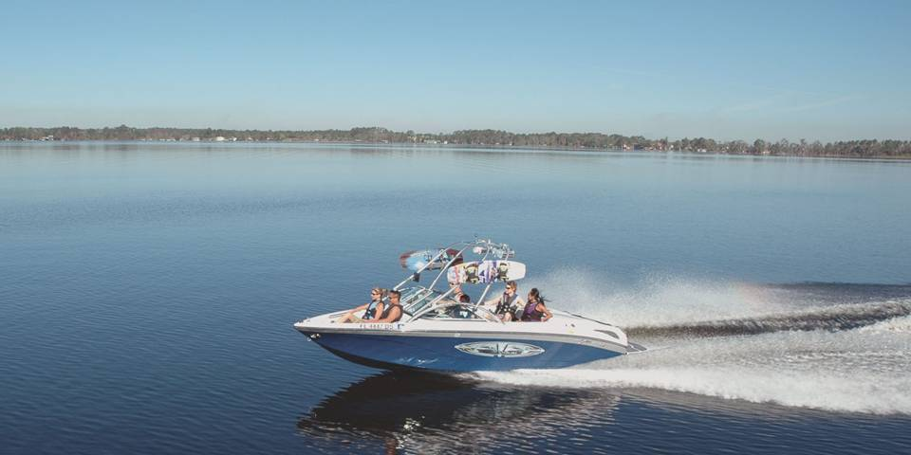
Powerboats and Sailboats
Sailboats differ from powerboats since they are at the mercy of the wind
Powerboats disrupt sailboats when sailboats are mooring, in light wind, or when blocking their wind
If you need to approach a sailboat, do so from downwind.

Slide 24
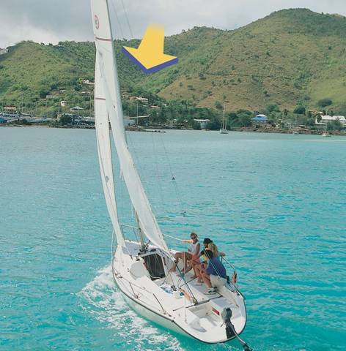
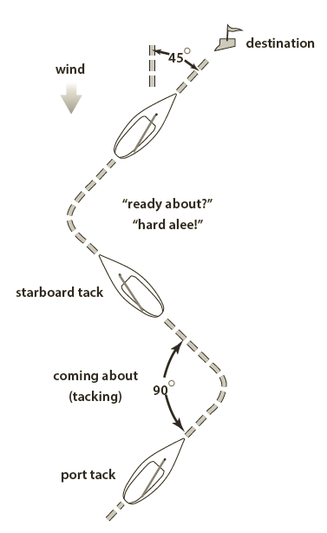
Powerboats and Sailboats
Tacking
wind
leeward side
windward side
Reprinted with permission from Fast Track to Cruising by Steve & Doris Colgate

Slide 25
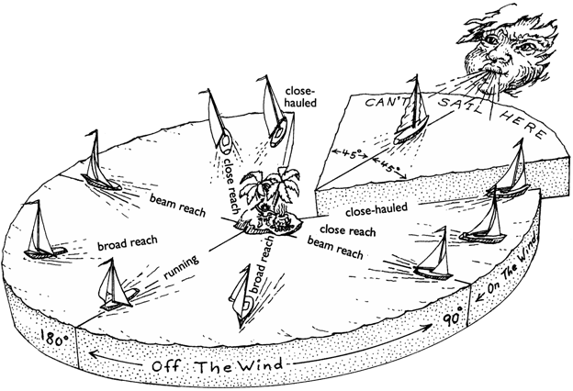
Powerboats and Sailboats
Directions in which a sailboat can sail
Reprinted with permission from The Complete Sailor by David Seidman

Slide 26
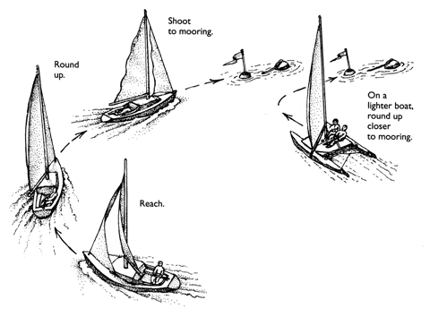
Powerboats and Sailboats
Sailboat skills
  Mooring & anchoring
  Wind and wake
  Blocking the wind
  Obscured vision
Reprinted with permission from The Complete Sailor by David Seidman

Slide 27
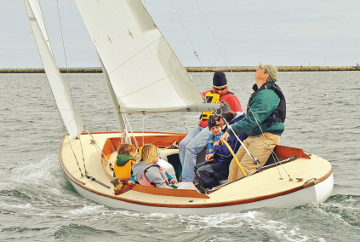
Student Activity
In most cases which vessel is the stand on vessel?
Powerboat
Sailboat
1
2

Slide 28
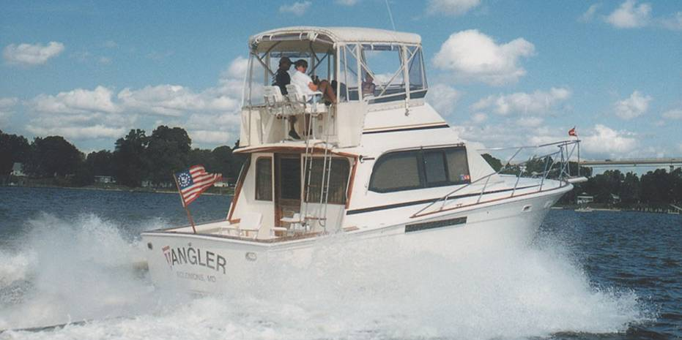
Carbon Monoxide Poisoning
Prevention
  Created by incomplete combustion
  Keep engine compartment well ventilated
  Don’t congregate around exhaust ports
  Use carbon monoxide detectors
  Odorless, colorless, poisoous
Reprinted with permission from Seaworthy: Essential Lessons from BoatU.S.;s 20 year Case File of Things Gone Wrong by Robert A. Adriance”

Slide 29
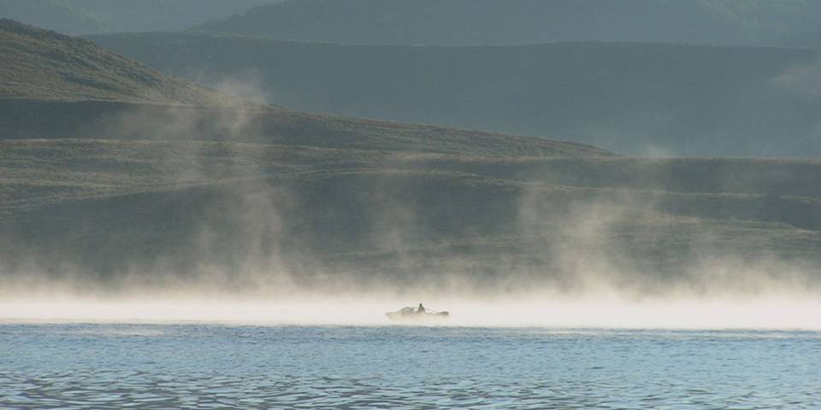
Weather
Know before you go
Update while you’re out
  Weather Radio
  WX on Marine VHF-FM Radio

Slide 30
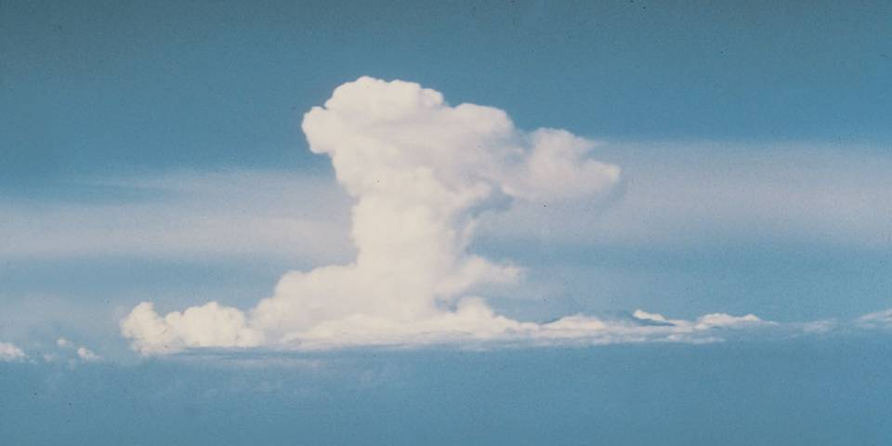
Weather
Warning signs
  Cloud formations
  Wind change
  Static on AM

Slide 31

Thank you
Illustrations provided by McGraw Hill Education
The

